Slide 1

Intelligent Peer Learning Platform: MERN Stack Meets Machine Learning
BY: SHIVAM KUMAR

Slide 2

The Future of Learning: Peer Collaboration Powered by AI
Traditional Limitations
Intelligent Solution
E-learning platforms lack personalized interaction and real-time guidance, leaving learners isolated
Our platform leverages MERN stack + ML to create dynamic, intelligent peer learning experiences
Smart Knowledge Exchange
Enables smarter, scalable, and engaging collaboration among learners worldwide

Slide 3



MERN Stack: The Backbone of Our Platform
MongoDB
Express.js & Node.js
React.js
Flexible NoSQL database storing user profiles, courses, and interaction data with seamless scalability
Robust backend API and real-time data handling powering instant communication and data processing
Responsive, interactive frontend delivering seamless user experience across all devices and platforms
Unified JavaScript stack ensures rapid development cycles and smooth data flow throughout the entire application architecture.

Slide 4
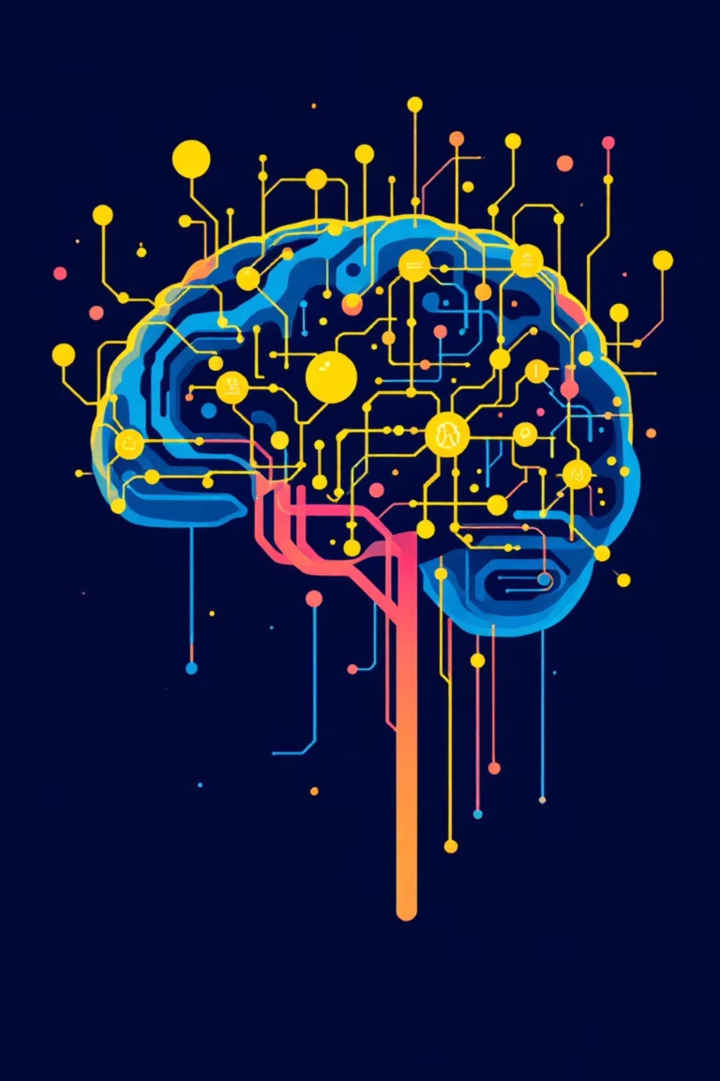
Machine Learning Integration: Making Learning Intelligent
01
Personalized Peer Matching
Advanced behavior analysis and skill profiling algorithms connect compatible learners for optimal collaboration
02
AI-Powered Support
Intelligent chatbots provide instant guidance, query resolution, and 24/7 learning assistance
03
Predictive Analytics
Automated feedback and progress prediction systems boost learner outcomes and identify improvement areas
04
Smart Communication
Natural Language Processing enables intelligent content recommendations and enhanced peer interactions

Slide 5

Core Features: Empowering Peer Learning
Peer Connection Hub
Course Management Suite
Secure chat interface enabling direct mentorship, collaboration, and knowledge sharing between learners
Complete CRUD operations with multimedia support for comprehensive learning content creation and delivery
Role-Based Access Control
Analytics Dashboard
Sophisticated permission system for admins, teachers, and students with tailored functionality and security
Real-time progress tracking with detailed insights and performance metrics for continuous improvement

Slide 6








Security & Scalability: Industrial-Grade Standards
Authentication
Cloud Integration
JWT and OAuth 2.0 protocols ensure secure user sessions and data protection across all interactions
AWS S3 integration provides scalable content delivery and reliable multimedia storage solutions
Containerization
Database Hosting
Dockerized deployment ensures consistent environments, easy scaling, and streamlined maintenance
MongoDB Atlas delivers reliable, globally distributed database hosting with automatic scaling

Slide 7

40%
24/7
85%
Engagement Increase
Availability
Retention Rate
Learners receive personalized mentorship anytime, anywhere, breaking geographical and time barriers
Early prediction and addressing of learning gaps dramatically reduces student dropout rates
Reciprocal knowledge exchange boosts student participation and active learning significantly
The platform supports diverse learning styles through AI-driven content adaptation, creating personalized educational pathways that maximize individual potential and foster collaborative growth.

Slide 8
Development Roadmap & Tech Stack Highlights
Frontend Development
1
React with Context API and Socket.io integration for seamless real-time chat and interactive user interfaces
2
Backend Architecture
Express.js MVC architecture with RESTful APIs and integrated AI model endpoints for intelligent processing
ML Implementation
3
TensorFlow.js and Hugging Face models embedded for advanced NLP capabilities and personalized recommendations
4
Production Deployment
CI/CD pipelines with Docker, Kubernetes orchestration, and scalable cloud hosting infrastructure

Slide 9

Case Study Snapshot: SkillSwap Platform
MERN Foundation
Full-stack peer learning platform with AI-enhanced chat functionality and intelligent feedback systems
Secure Authentication
Google OAuth and JWT implementation ensures secure, seamless user access and data protection
Trust & Accountability
Comprehensive user rating system builds community trust and peer accountability through transparent feedback
Universal Access
Responsive design guarantees optimal accessibility and functionality across all devices and screen sizes

Slide 10

Join the Intelligent Learning Revolution
Harness MERN + ML Power
Empower Every Learner
Innovate Education Together
Build smarter, more connected learning communities that adapt and evolve with user needs
Deliver personalized, AI-driven peer support that transforms educational experiences worldwide
The future is collaborative and intelligent — let's revolutionize how the world learns and grows
Ready to transform education? Let's build the future of intelligent peer learning.

